Slide 1
CAR PRICE PREDICTION
By Avinash Patel

Slide 2

INDEX
Importing Dataset
Cleaning The Dataset
Visualization
Skewness and Outlier Removal
Model Selection
Hyperparameter Tuning
Saving The Model

Slide 3
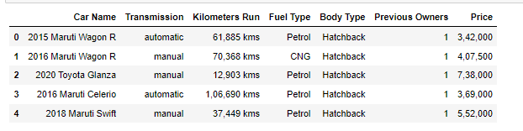
Importing Dataset
First step is to import the csv file into the Jupiter notebook.

Slide 4
After importing we check any of the columns have null values or not and also see some basic information's about all the columns.
Like number of unique variables in each columns.

Slide 5
Cleaning The Dataset
After some information about the dataset we are going to clean the columns individually.
Categorical Column: There are Four categorical column one of them is car name and we are going to delete this column as it is of no use for us. The other column is Kilometres run, Fuel Type, Body Type, Transmission.
Numerical Column:
Treating Kilometres Run column:As it is the number of kilometres rum while with the previous owner it has km written with it which makes it a categorical column so I treated this column by deleting all the subscripts with km and keep only the integer values.

Slide 6
Treating Fuel Type column: As for this column I deleted the +1 from some fuel types and then after doing that I left with sone fuel types which are the same but the capitalisation is different so I merged the rows with the same name as one name.Treating last_rech_date_da column: By looking at the xml file this column has mostly 0 as values. Hence I am checking how many 0 there are.
Treating Price columns : Treating this column is a little tricky because not only it contains commas but also it has three different values one is the full amount the other is subscript Lakh and the other subscript crore. So I have to first delete all the comas and the segregate all the values with lakh and multiplied it with 100000 and for the rows which have subscript crore I multiplied them with 10000000.

Slide 7
Treating Transmission column:This column has three different types of automatic written which the program is treating three different and the same case is with manual also. So I merged all the automatic rows to single name AUTOMATIC and I have done the same for the MANUAL rows ,after replacing all the automatics and the manuals we have left with only two row type automatic and manual.

Slide 8
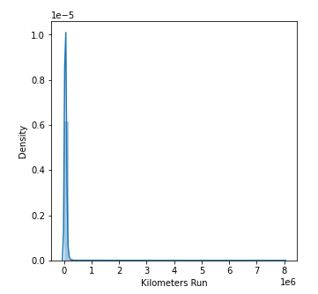
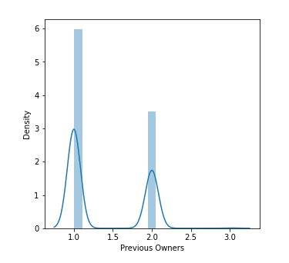
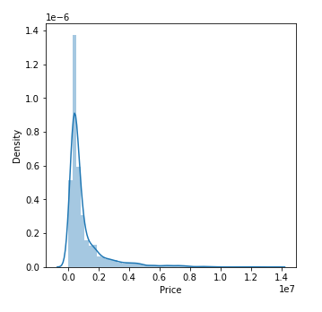
Visualization
Distplot:

Slide 9
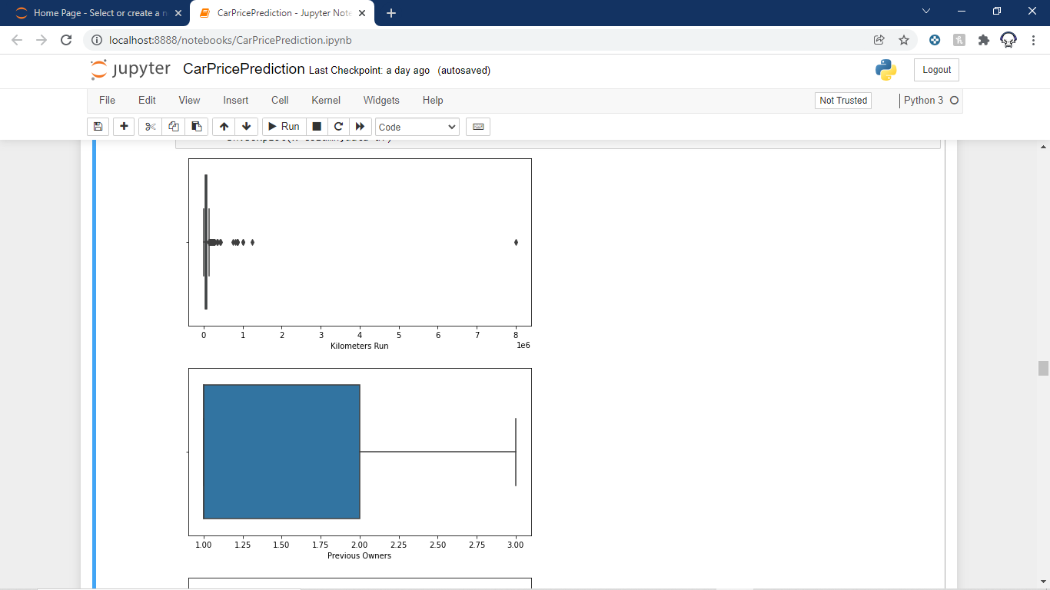
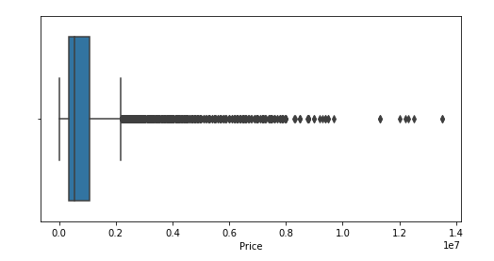
Boxplot

Slide 10
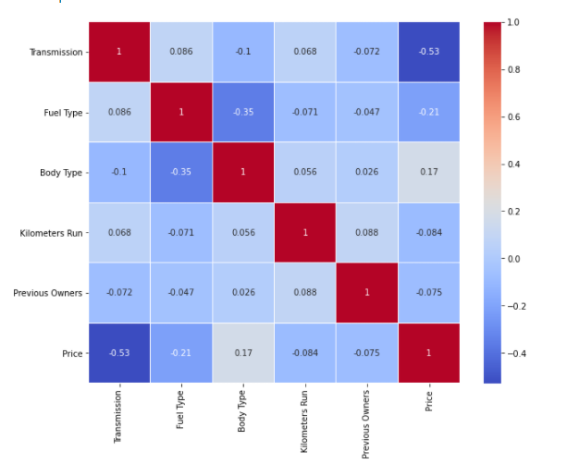
Heatmap

Slide 11
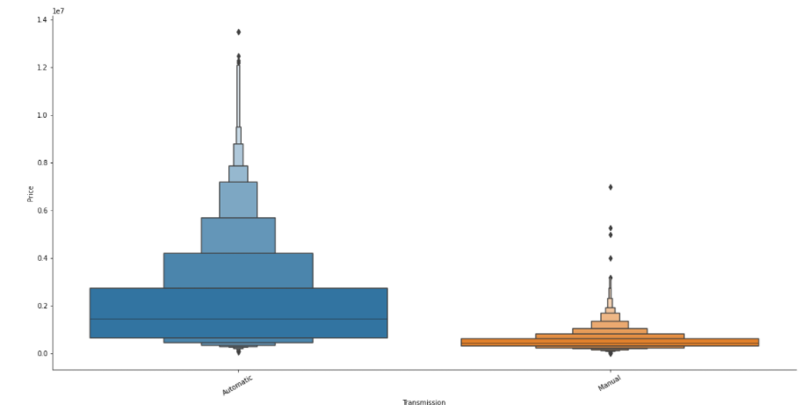
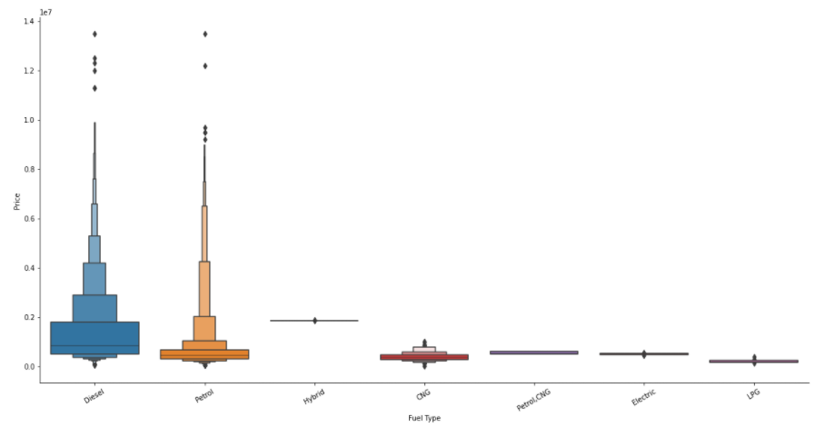
Catplot

Slide 12
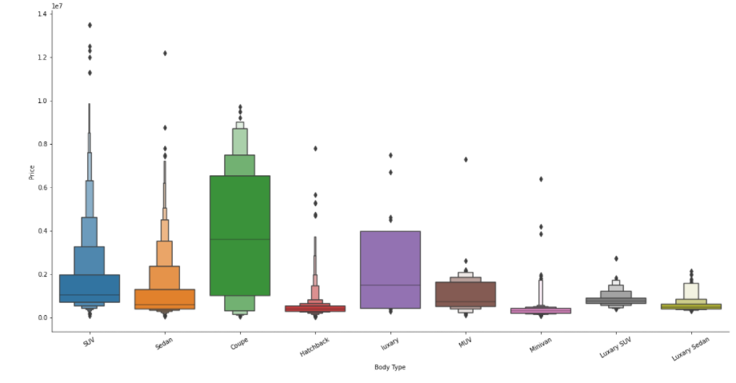

Slide 13
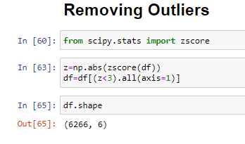
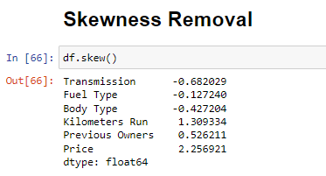
Skewness and Outlier Removal
Now we try to remove some outliers with z-score and then we remove some skewness from some columns.

Slide 14
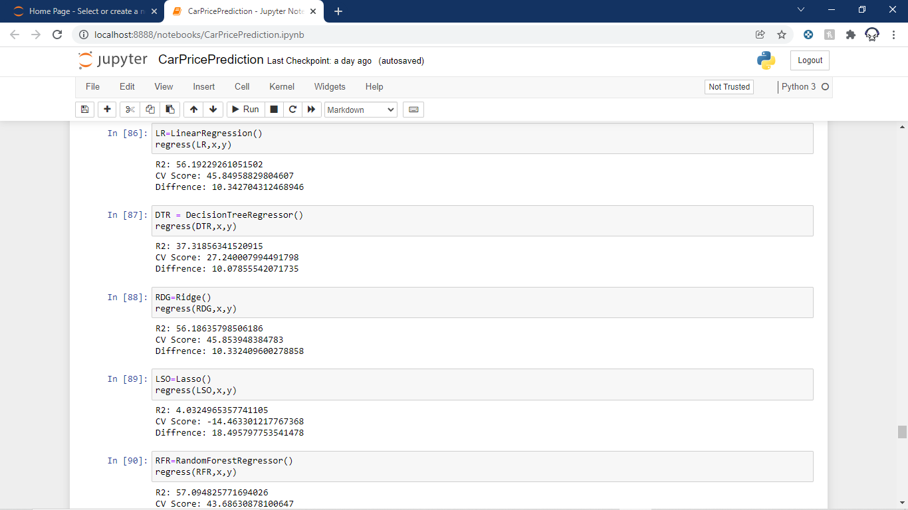

Model Selection
Now we will see some accuracy and cross validation scores of different model so that we can select the best fit model for our project.
Hence XGBoost Regressor has the lowest difference between accuracy and cross validation score.

Slide 15
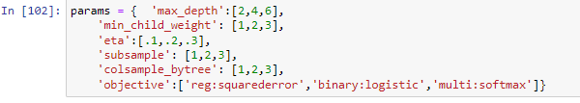
Hyperparameter Tuning
Now as we selected XGBoost Regressor as our model. Now we are going to tune its parameters to make the model a little better.
Parameters are:

Slide 16
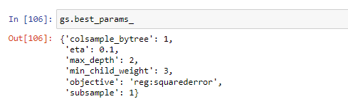
After doing the tuning we find out the following.
The Above parameters are the best parameter for this type of dataset for our model. So finally we fitted the data with these parameters.

Slide 17
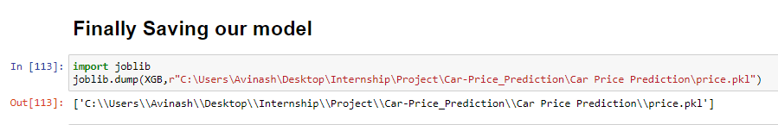
Saving The Model
The final job is to save the model which is done by Joblib library.

Slide 18
THANK YOU!!!

